Slide 1


Flight Delay Prediction
Presented by: Vardaan Kishore Avin Sharma Gunjan Mishra Isha Goyal

Slide 2




Our Team
Isha Goyal
10432823
Gunjan Mishra
10440642
Avin Sharma
10442559
Vardaan Kishore
10434327

Slide 3

Introduction
Flight delay and cancellations are a serious and inevitable problem part of the air travel all over the world. As the flight delays have been increasing it’s affecting the World aviation and also cost passengers, airlines with huge billions of dollars every year.
There was a recent study performed by FAA showed that passengers in the United States lose about $16 billion a year due to “schedule buffer, delayed flights, flight cancellations, and missed connections”. Therefore there is a need to analyze the flight delay times.

Slide 4
Business Understanding
Profound Question
Can we build a model to predict from the flight on-time performance database if a given departure time of a particular flight will be delayed?
Goal
Predict whether flight is delayed or not

Slide 5

Data Understanding
Data Source
The database used provides details for every flight that takes off at any airport in the United States.
Link for the data source: https://www.transtats.bts.gov/DL_SelectFields.asp?Table_ID=236
This dataset for flight prediction is originally from Bureau of Transportation Statistics.
Link for the data source: https://www.ncdc.noaa.gov/
Dataset of weather is from National Centers For Environmental Information.

Slide 6
Data Understanding
This database provides details for every flight that takes off anywhere in the US.
It consists of 110 attributes that are categorical variables such as Year, Month, Quarter, DayofMonth, DayOfWeek, FlightDate, Reporting_Airline, Origin, OriginCityName etc.
Here we consider the data for the years 2013 and 2014.
We could potentially work on more but because of the lack of computation we stick to these two years

Slide 7
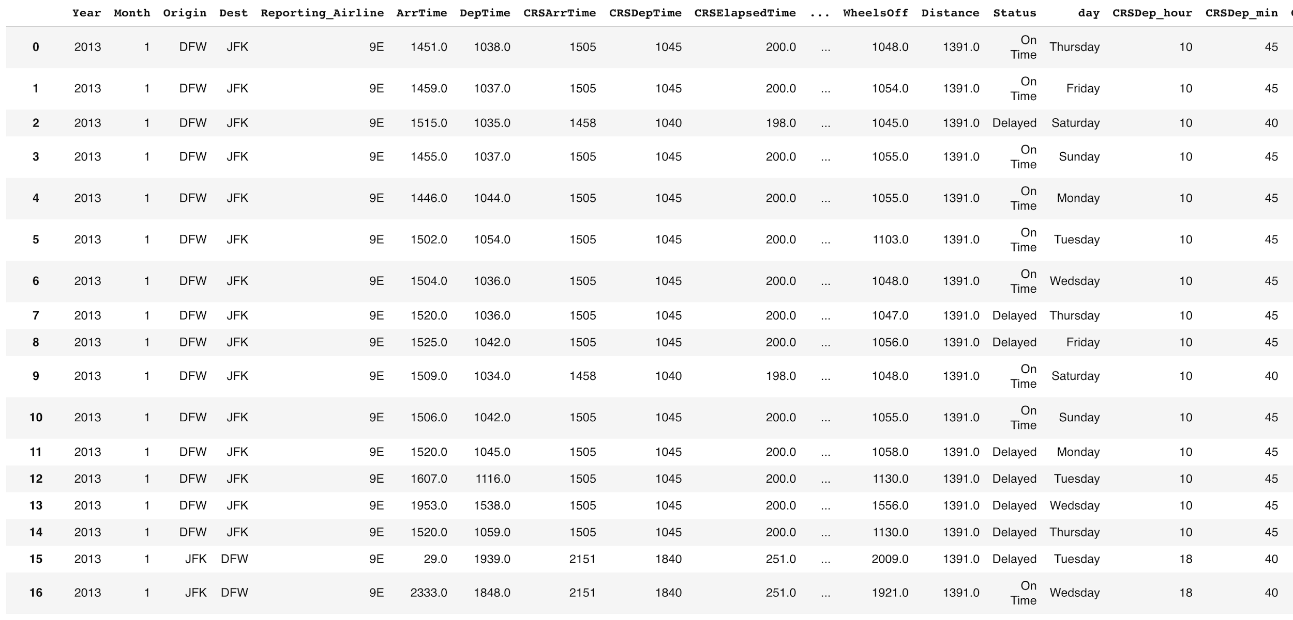
Dataset

Slide 8
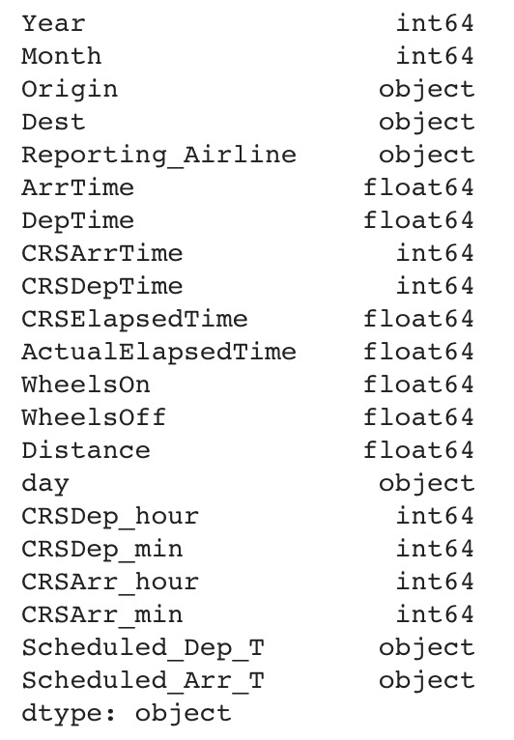

Attributes of Data

Slide 9
Data Preprocessing
We remove the columns which have more than 80% of its data missing.
After this we are left with 65 features- we plot the correlation matrix for these 65 features
Then we remove all the features which are not related with our output( Arrival Delay)
After this we are left with 22 columns
We try to find the most important features out of these using decision tree.
We are now left with 12 features which we finally use for our classification.
Finally we have 12 columns and 180,000 rows.
Now we try to explore and understand the data by plotting various graphs
We have split our data into Training: Testing by 70:30 ratio

Slide 10
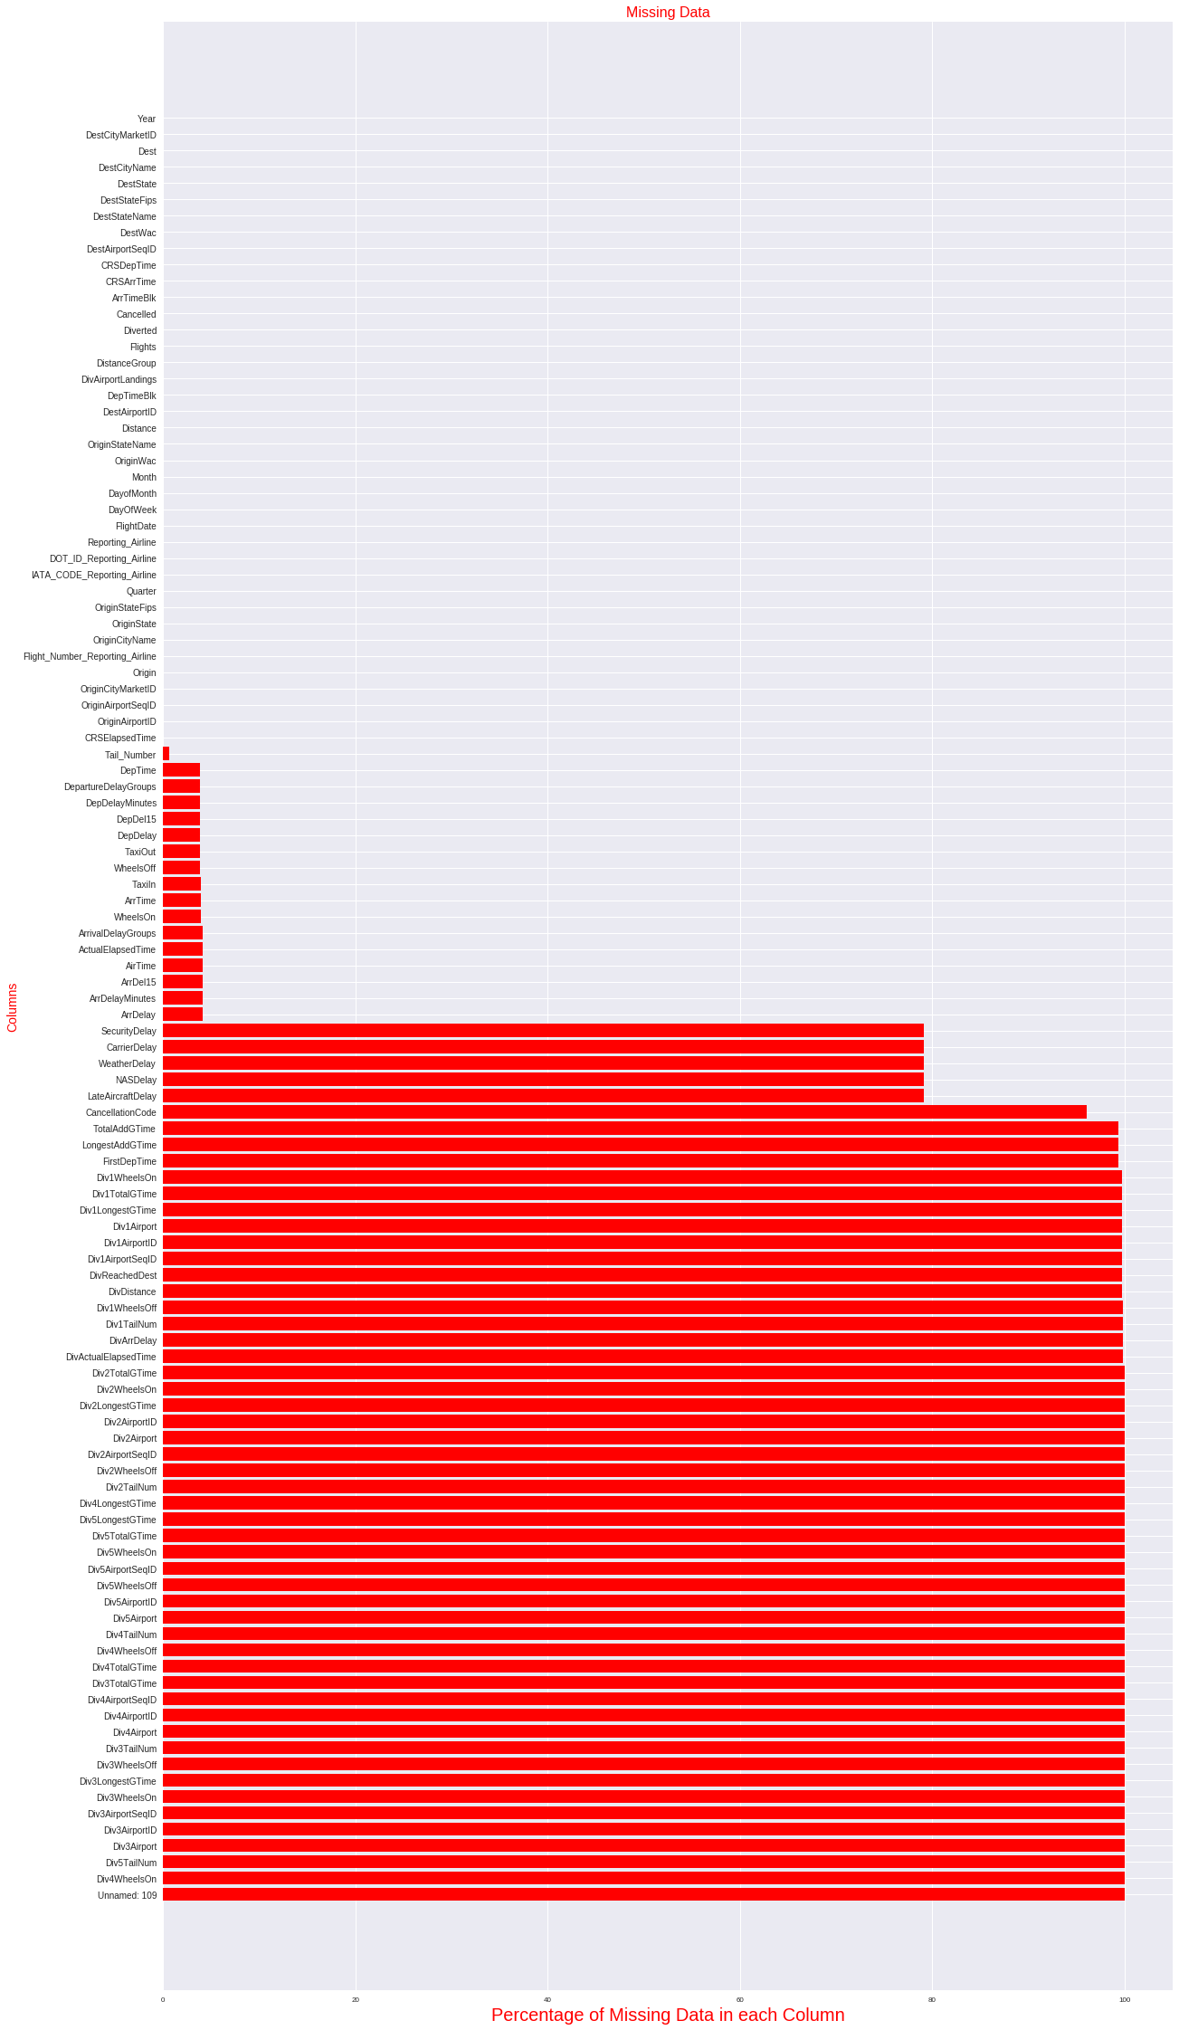
Exploratory Data Analysis
A
T
T
R
I
B
U
T
E
S
Percentage of data missing in each column
Notes:
EDA-Check missing data

Slide 11
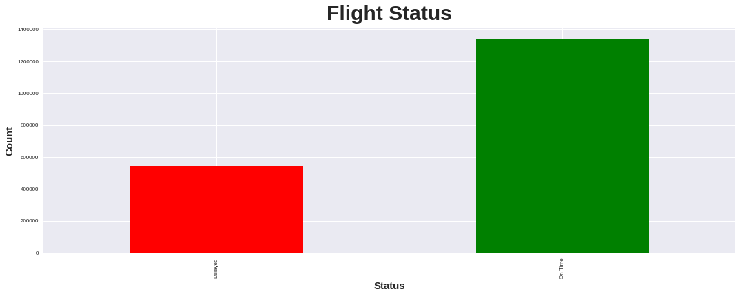
Data Visualization (Ontime vs Delay)
Notes:
Visualization after removing 80%

Slide 12
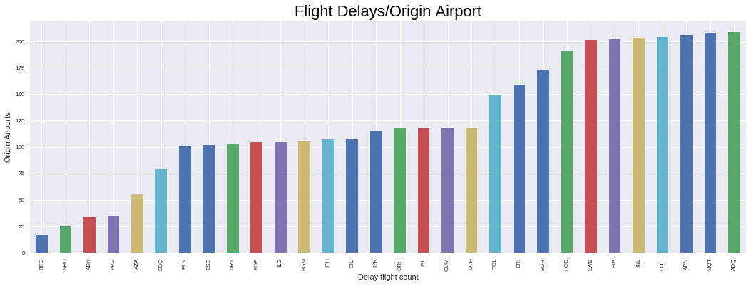
Top 30 Origin Departure Flight Delay
Notes:
Alaska- Most delayed

Slide 13
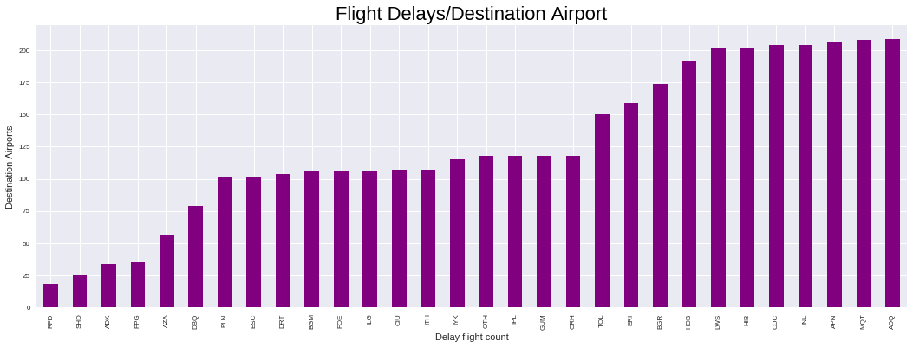
Top 30 Destination Arrival Flight Delay

Slide 14
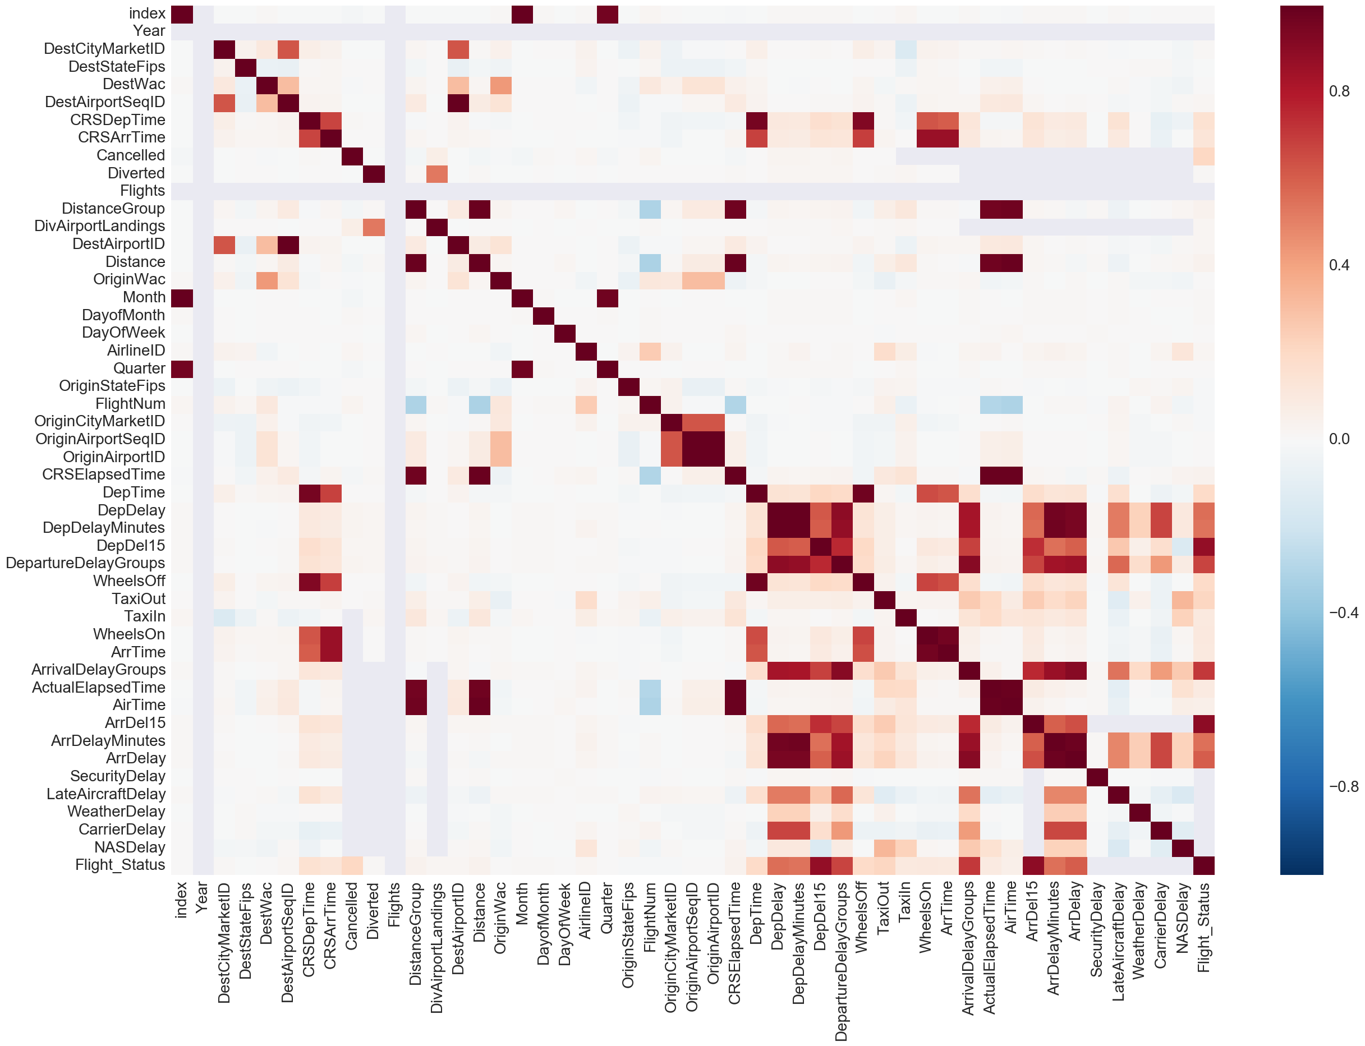
Correlation Heat Map

Slide 15
Definition of Delay
Here we create a custom column ‘Flight Delay’
This is defined as if Arrival time is delayed >15 minutes, we assign the flight to the delayed category
The other category is ‘OnTime’

Slide 16
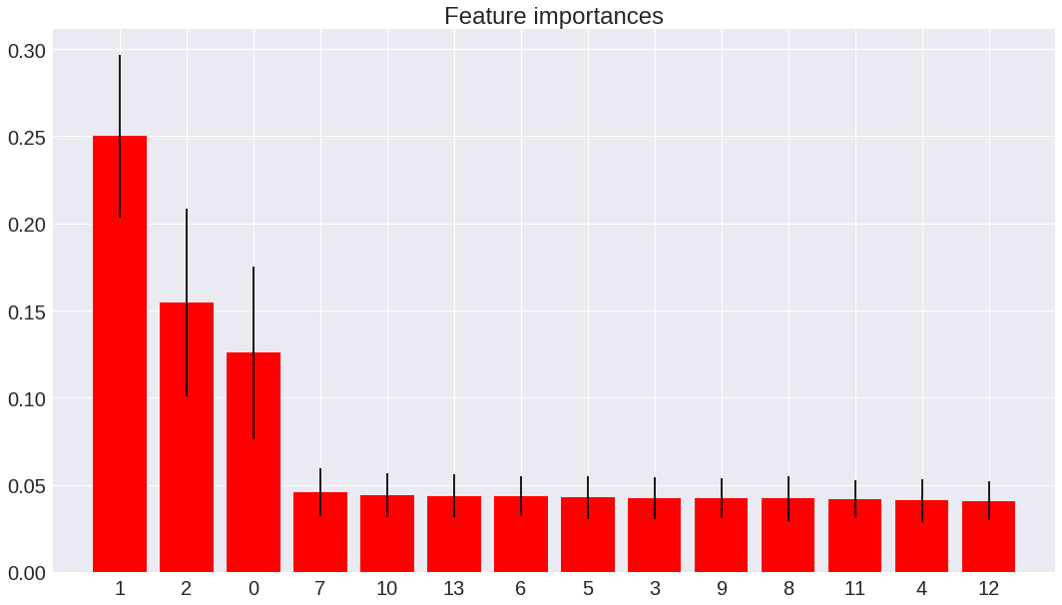
Importance Graph
Notes:
Gini index

Slide 17
Classification Models Used
K-Nearest Neighbors
Naive Bayes
Decision Tree
Random Forest
Neural Network
Adaboost

Slide 18
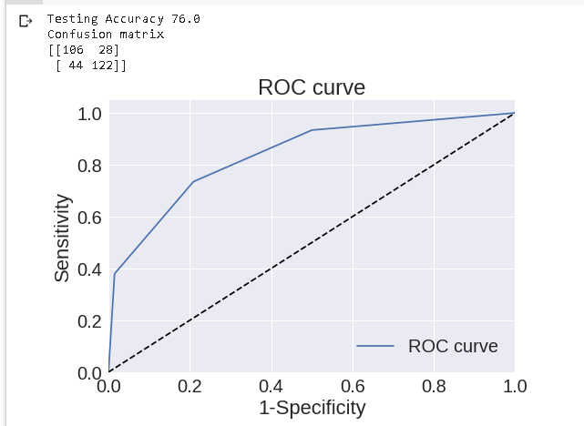
K-Nearest Neighbor
The data is split into 70% training, 30% testing.
K selected by testing different values.
Accuracy: 76%

Slide 19
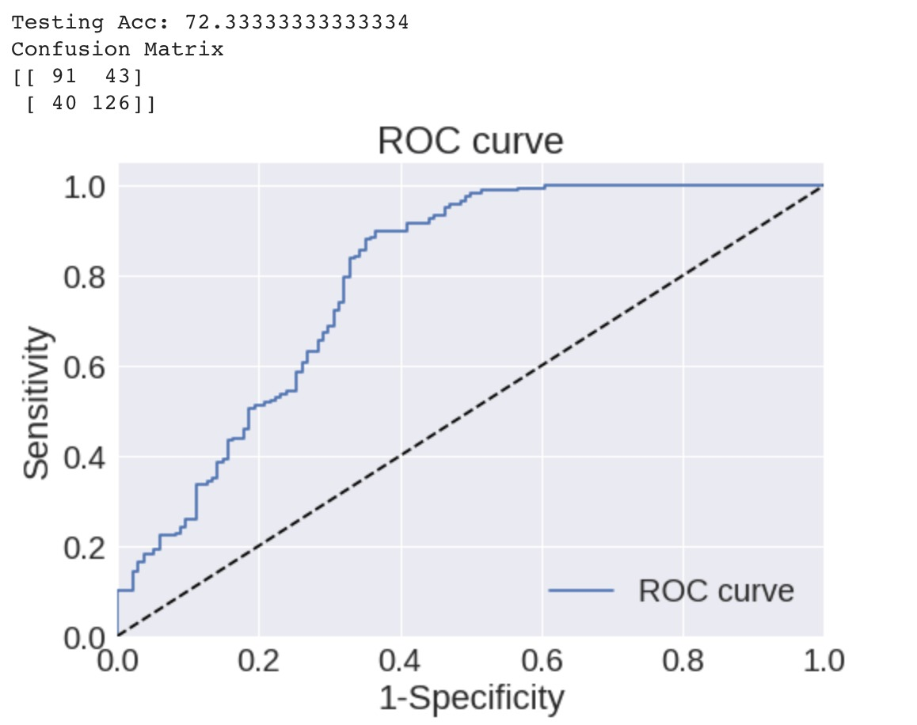
Naive Bayes
Simple yet powerful technique based on Conditional Probability.
Accuracy : 72.3 %

Slide 20
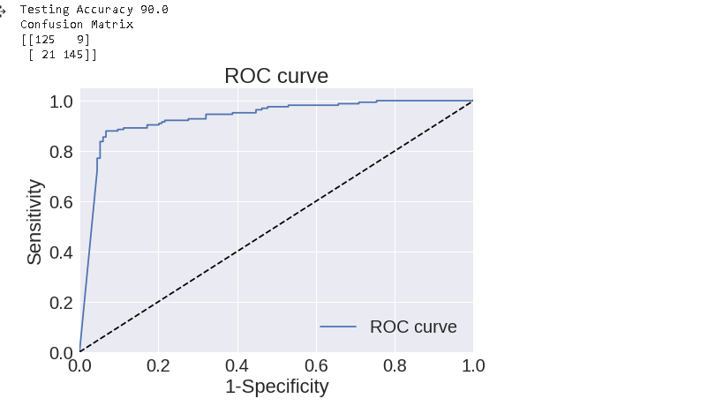
Neural Networks
Simple feedforward Neural Network.
3 - Hidden Layers: (10, 5, 2)
Activation, Output Functions - tanh, sigmoid
Accuracy : 90 %

Slide 21
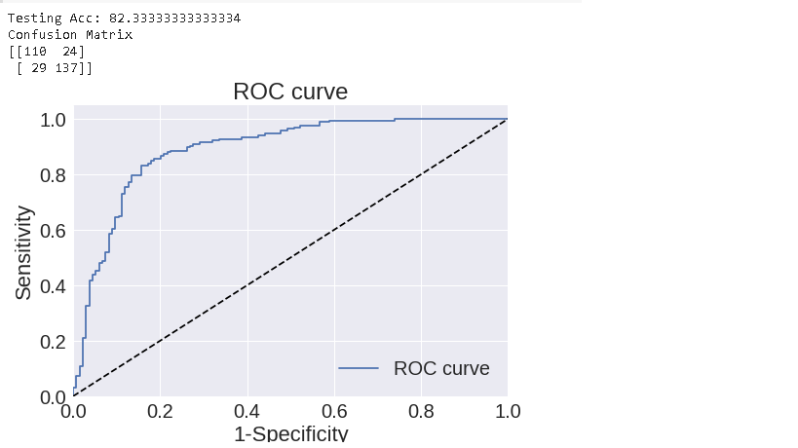
AdaBoost
One of the most used classification algorithm, based on weak learners.
It deploys weak learners, called stumps together and does weighting of the misclassified examples.
This is done iteratively to build a robust, strong classifier.
In our model we use 200 weak learners
Accuracy : 82.3 %

Slide 22
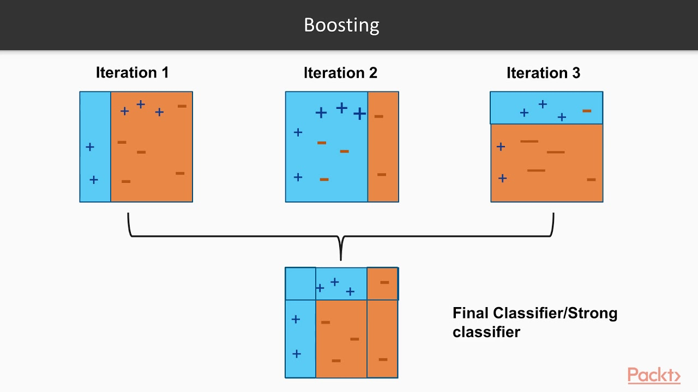

Slide 23
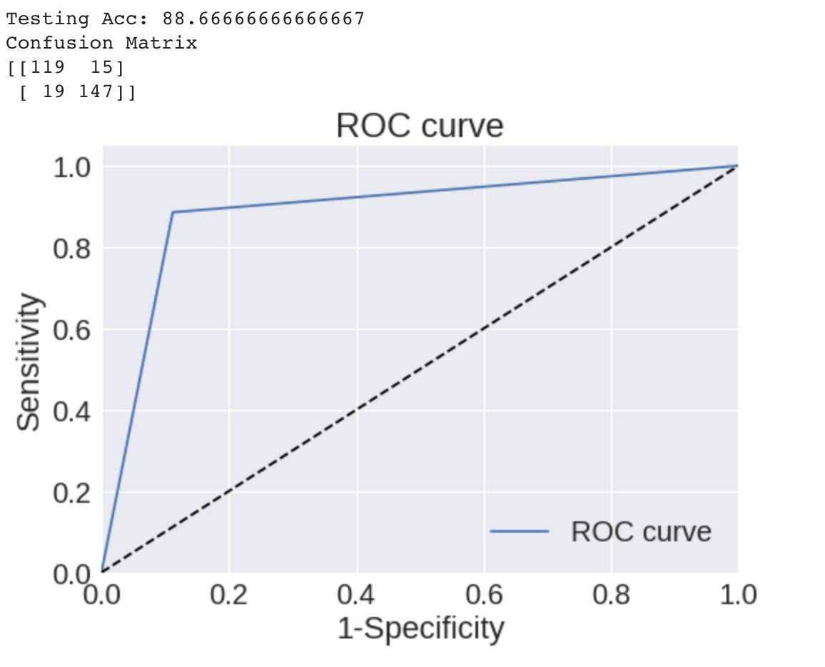
Random Forests
Random forest is a collection of decision tree classifiers
It is based on the concept of Boosting
Here we use a random forest with a maximum depth of 7
Accuracy : 88.6%

Slide 24
Analysis of Results
Based on the ROC curve, the confusion matrix and the testing accuracy we can see that Neural Networks are the best models .

Slide 25
Comparison results
MODEL | Accuracy
KNN | 76%
ANN | 90%
Navie bayes | 72.3%
Random fore | 88.66%
AdaBoost | 82%

Slide 26
BUT WAIT!
There is more!

Slide 27
Inclusion of weather parameters
We get the hourly data from the weather website for each of the airports and we average out the data for the whole day for each day of the month for each station.
So now the number of features we have are 14, including the previous 12.

Slide 28
Inclusion of weather parameters
In the previous section we only use the parameters provided by the government about the flights.
In real life there are various factors which go into prediction of a flight delay.
Weather is the most important in this.
So now we try to integrate weather into the data and try to predict the delay by using weather parameters like precipitation and humidity.

Slide 29
Inclusion of weather parameters
Given the complexity of collecting weather data and merging it with the flight data, we only consider the data for four airports for january of 2013,2014.
The airports are JFK,ORD,LAX,SFO,ATL
The weather parameters we consider, which we think affect the most are windspeed, precipitation, visibility

Slide 30
Model Used
Given shortage of time we use one model for this.
A deep neural network with the following architecture.
64-128-128.
A dropout of 0.3,0.5,0.5 is added to avoid overfitting.
We use SGD as our optimizer and this is trained for 400 epochs.

Slide 31
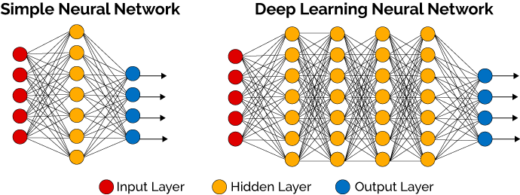

Slide 32
Results
We get the following results.
Accuracy of 74% on the test data.
Confusion matrix as follows
[100 35]
[46 119]

Slide 33
Conclusion
If we just use the flight data, we see that we are fitting to the data given and not considering external factors, thus giving a big accuracy.
When we start to consider external factors like weather which is a hard time series problem,we see the effect on the results.
This shows that we need a much more complex mathematical model to predict the airplane delays in realtime.

Slide 34

Future Work
Even though the deep learning model gave an average accuracy, we can use models like the long short term memory which are state of the art in time series modelling for forecasting.

Slide 35
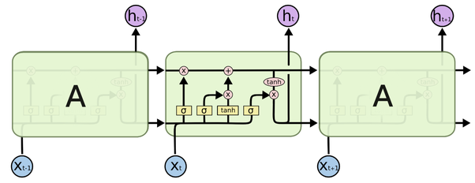

Slide 36

Thank You!

